Slide 1
E_R Modelling & Logical Design Review
Mcfadden, F, Hoffer J,and Prescott M Modern Database Management
Connolly, T and Begg, C Database Systems
Carter, P, The Relational Database

Slide 2
Module Outcomes
demonstrate a critical understanding of the theories underpinning a range of database design and management issues, including methods, technologies and emerging trends;
critically evaluate the role of CASE tools in the design, development and management of database systems;
design and implement a database to meet a set of user requirements using advanced database design approaches and extended features of a DBMS
assess the organisational context, roles and tools for effective utilisation of an enterprise’s data resource

Slide 3
Session Outcome
  Refresh your understanding of
  E-R Modelling
  and
  Logical Database Design
  Techniques

Slide 4
Reading
Review your notes from previous work in this area
And
McFadden & Hoffer

Slide 5
Database Development LifeCycle
Project Initiation
and Planning
Conceptual
Design
Logical Design
Physical Design
Top Down Approach
Implementation
Maintenance

Slide 6
Extended modelling structures
Recursive Relationships
Exclusive Arcs Relationships
Subtypes
Identification Dependence

Slide 7
Recursive Relationships
supervises
employee
is supervised by
An employee supervises 0, 1 or more employees
An employee is supervised by an employee

Slide 8
Supertypes and Subtypes
Staff
Sales Staff
Name
Address
Payroll number
Job title
Department
NI number
Age
Date of birth
Sales quota
Bonus
Car allowance
Territory

Slide 9
Supertypes and subtypes
Rules for attributes:
1. The supertype entity has attributes that apply to ALL subtypes
2. Subtypes have only the ADDITIONAL attributes that are unique to them
supertype
STAFF
SALES
ALL are entities!
OFFICE
PRODUCTION
subtypes

Slide 10
Identification Dependence
An apartment will have a number, eg 102.
That is not a unique, identifying attribute
Why not?
What is the solution?
(a) create a new attribute to act as the identifier
OR
(b) recognise that the apartment number is unique for a particular building
building
apartment

Slide 11
Identification Dependence
(b) is a better solution, the ER diagram would show this as:
BUILDING
I
APARTMENT
The attributes for each entity would be as follows:
BUILDING (building-name, building address etc)
APARTMENT (apartment-number, etc etc)
We don’t need to duplicate building-name as an attribute on the apartment entity, as that is implicit in the diagram, by the use of the Symbol above.

Slide 12
Exclusive Relationships
(exclusive arcs)
order
account
customer
telephone
customer
Order is linked to either an account customer OR a telephone customer, but not both

Slide 13
Database Development Life Cycle
Project Initiation
and Planning
Conceptual
Analysis
Logical Design
Database development activities during the development life cycle
Physical Design
Implementation
Maintenance

Slide 14
Logical Design
This is the process of transforming the entity model into a logical model that can be implemented
We will deal only with the relational model
The Relational Data Model represents data in the form of relations
A relation is a logical representation of the conceptual model - again independent of the physical considerations
(very different from a relationship)

Slide 15
Logical Design
Objective :
    to produce an initial design for a database, assuming it is to be implemented as a relational database
Task :
    we take the Conceptual (ER) model and use it to produce set of relations.
    we carry out this task by following a set of ‘rules’ to ensure we achieve a complete map of the requirements as represented by the entity model

Slide 16
A Relation
is a logical definition of a table (implemented as a table)
can be seen as eventually a set of named columns and a number of rows of data
has a primary key, which is an attribute (or attributes) that uniquely identifies each row in a relation
may have foreign keys, which are the primary key of another relation
has a structure which is expressed using a shorthand form: CAR(engine_number,colour), primary key underlined, foreign key(s) in italics

Slide 17
Which stage do each of the following terms belong to?
relation
relationship
foreign key
primary key
identifier
entity
Conceptual
Analysis
Logical
Design

Slide 18
3 Levels of Database Development
Conceptual Model
  Entities, Attributes, Identifiers, Relationships, Occurrences, Cardinality, Optionality
Logical Model
  Relations, Keys (Primary, Foreign, Compound), Attributes, Normalisation
Physical Model
  Tables, Fields, Keys (all 3), Records, Relationships, Cardinality

Slide 19
Logical Design - Stage 1
custno
CUSTOMER
Customer(custno, name, d-o-b)
1. Map Entities
(a) each entity becomes a relation with the same name
(b) the identifying attribute becomes the primary key
(c) other attributes provide non-key fields, names unchanged

Slide 20
Logical Design - Stage 2
RELATIONSHIPS from the ER model
  are represented by foreign keys
foreign keys must contain a value, they can’t contain an empty value - this means that we have ‘rules’ which specifically deal with optionality from the ER model
Note : this is a ‘translation process’ taking each entity & relationship, to produce the relations, with the appropriate keys

Slide 21
Example : 1:M Relationship
WARD
PATIENT
primary key of the ‘one’ becomes a foreign key in the ‘many’
Ward(wardno,....)
Patient(patno,...wardno...)
NOT the other way round !

Slide 22
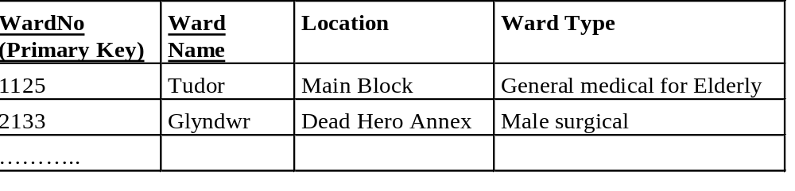
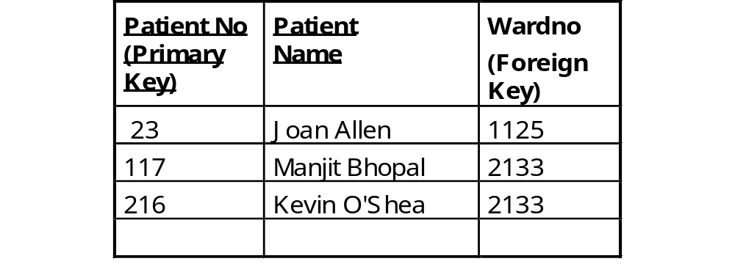
The data in the tables ...
Ward
We can easily answer queries such as :
What ward is Joan Allen in?
Who is in Glyndwr ward?
Patient

Slide 23
Example : 1:M + optionality
In the example below, patients may not be in a ward…...
O
PATIENT
WARD
An extra relation is required, to represent this relationship
Ward(wardno,......)
Patient(patno,.........)
Occupancy(patno,wardno)
WARD
O
O
PATIENT
What relations are derived from here?

Slide 24
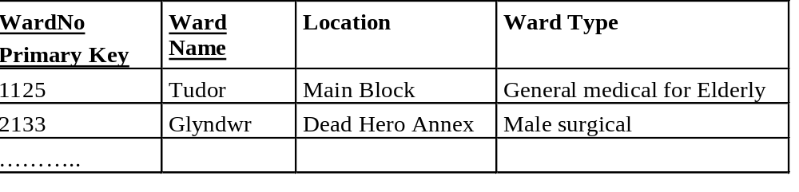
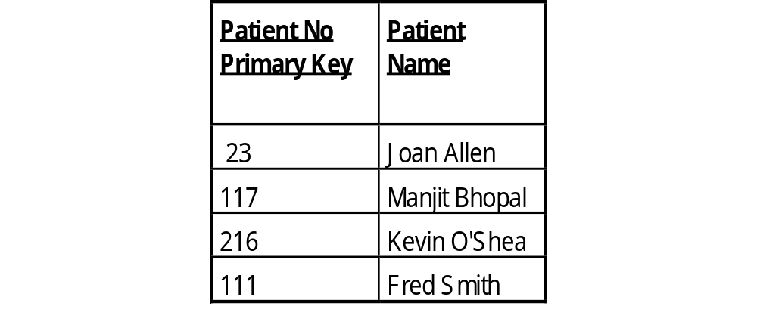
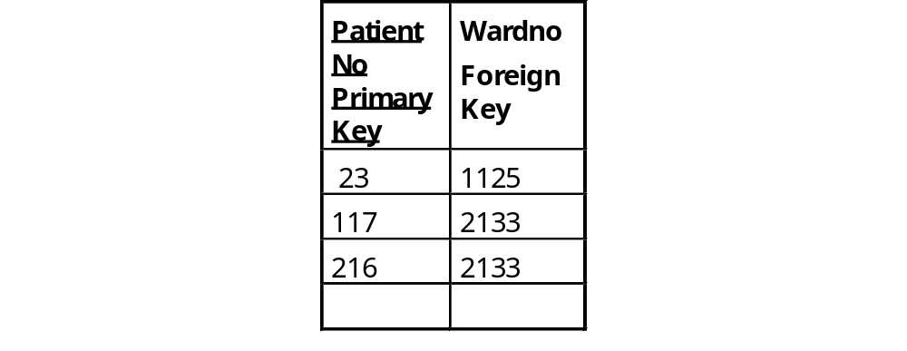
The data in the tables ...
Ward
Which ward is Manjit Bhopal in?
Which ward is Fred Smith in?
Patient
Occupancy

Slide 25
1:M Relationships - Summary
No optionality or optionality at the ‘many’?
  A relation for each entity
  the primary key of the ‘one’ becomes a foreign key in the ‘many’
Optionality at the ‘one’ ?
  A relation for each entity
  an additional relation, with same primary key as the relation from the ‘many’, foreign key from the ‘one’

Slide 26
Example - M:M relationships
contains
MODULE
COURSE
Course(courseno,.........)
Module(modcode,.......)
Course_Module(courseno,modcode)
An additional relation, compound primary key, made up of the primary keys from each relation is needed.
Would optionality change this? NO

Slide 27
1:1 Relationships
Employee
O
O
Car
drives
How would this be represented?
Remember we wish to avoid NULL/empty values in foreign keys
Employee(empno,.........)
Car(car_regno,.......)
Drives(empno, car_reg_no) or
Driven(car_reg_no, empno)
plus

Slide 28
1:1 relationships - Summary
No optionality?
  consider combining into one relation
Optionality at one side of the relationship?
  A relation for each entity
  primary key of relation representing A becomes foreign key in relation representing B
Optionality at both ends?
  A relation for each entity
  an additional relation, with the primary key coming from A or B, foreign key coming from B or A
A
B
A
B

Slide 29
Identification Dependence
*Note : screen and performance are weak entities
CINEMA
Cinema(cinema code,..........)
houses
Screen(cinema code,screenno,....)
SCREEN
shows
Performance(cinemacode,screenno,datetime....)
PERFORMANCE
FK
Identification dependence produces relations with compound primary keys. Note: parts of the compound key are also foreign keys

Slide 30
Recursion 1:M
Treated very much as for previous examples
O
manages
Employee(empno,.....mgrempno)
Employee
O
manages
Need to use a unique name for the FK
Not all employees have a manager …need an additional relation
O
Employee
Employee(empno,.....)
Manages(empno,mgrempno)

Slide 31


The data in the tables ...
Employee
We can easily answer queries such as :
Who manages Joan Allen?
Who manages Kevin O’Shea?
Manages

Slide 32
Subtypes
EMPLOYEE
Employee(empno,name, dob,...)
Academic(empno,grade,….)
Technical(empno,….)
Support(empno,….)
ACADEMIC
TECHNICAL
One relation for each entity.
All sub-types have the same primary key as the super-type.
SUPPORT

Slide 33
Exclusive Arcs
We can’t have null values in foreign keys, so that dictates which relation(s) has the foreign key
Flight
Holiday
Uses
Coach
Holiday(holiday-code,…..)
Flight(flight-id,holiday_code….)
Coach(coach-id,holiday_code….)

Slide 34
Summary (1)
Logical design involves mapping the conceptual design into a suitable form for implementation
If the target DBMS is RELATIONAL then we map to relations, or tables
We have derived a set of relations…..
using a set of ‘rules’
  Avoiding the use of NULL, or empty values in foreign key fields

Slide 35
Summary (2)
we now know how to use a set of rules to guide us in carrying out this mapping to ensure that we preserve the semantics, or meaning, that is captured in the entity model, and ensure a complete mapping of the information requirements
This process is fairly mechanical, and could be carried out by a CASE tool, but may need careful checking

Slide 36
Student Feedback
Have you understood this lecture?
A. Yes - all of it
B. Not sure/ most of it
C. Not sure/ some of it
D. No - none of it

Slide 37



Questions ?
?
?
?
?
?

Slide 38
Student Centred Activities
Read the handout and do the exercises before your next tutorial
Refresh your memory, via your earlier notes on:
Entity-relationship Modelling
Logical Design
Read Connolly & Begg chapter
Then SQL for next week

